Slide 1
Bioinformatics
Faster, better, stronger

Slide 2
De stof komt uit de college presentaties en Jonathan Pevsner "Bioinformatics and Functional Genomics"
(Wiley Blackwell; 3e editie) en een aantal extra papers
(deze worden niet expliciet in de betrokken colleges genoemd, en zijn te vinden onder "achtergrond").
Lecture | Topic | Chapter | Pages | Comments
1 | Bioinformatics | 1 | Helemaal
2 | Access to seq data | 2 | Helemaal | Niet "Command line access"
3 | Sequence Alignment | 3 | 70-103 | Niet box 3.5, box 3.7, box 3.8
4 | BLAST | 4 | 121-134, 138-143, 145-159 | Niet fig.4.14, box 4.1, p.143 E- en p-values
5 | Database searching | 5 | 171-177 | Niet box 5.1
6 | Next Generation Sequencing | 9 | 377-384

Slide 3
Presentation content
Chapter 5: pg. 171-177

Slide 4
Chapter 5:
Advanced Database Searching
Jonathan Pevsner, Ph.D.
pevsner@kennedykrieger.org
Bioinformatics and Functional Genomics
(Wiley-Liss, 3rd edition, 2015)
You may use this PowerPoint for teaching purposes

Slide 5
Position specific iterated BLAST:
PSI-BLAST
The purpose of PSI-BLAST is to look deeper into the database for matches to your query protein sequence by employing a scoring matrix that is customized to your query.

Slide 6
PSI-BLAST is performed in five steps
[1] Select a query and search it against a protein database
B&FG 3e
Page 172

Slide 7
PSI-BLAST is performed in five steps
[1] Select a query and search it against a protein database
[2] PSI-BLAST constructs a multiple sequence alignment
then creates a “profile” or specialized position-specific
scoring matrix (PSSM)
B&FG 3e
Page 172

Slide 8
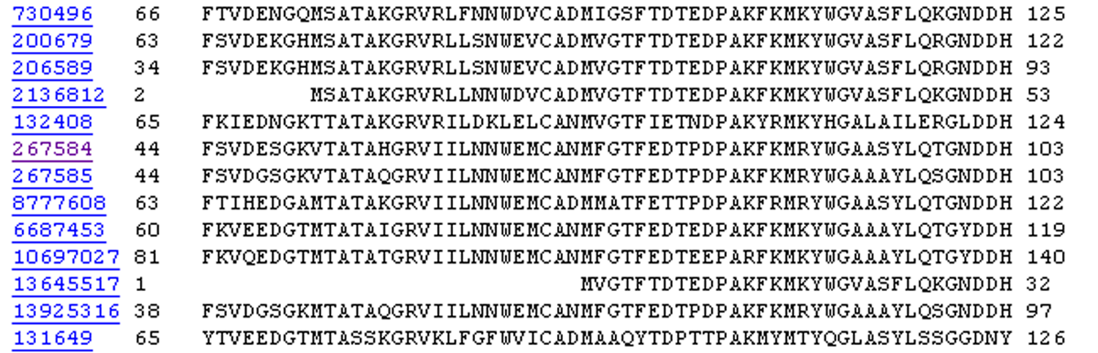
Inspect the BLASTP output to identify empirical “rules” regarding amino acids tolerated at each position
R,I,K
C
D,E,T
K,R,T
N,L,Y,G

Slide 9
A R N D C Q E G H I L K M F P S T W Y V
1 M -1 -2 -2 -3 -2 -1 -2 -3 -2 1 2 -2 6 0 -3 -2 -1 -2 -1 1
2 K -1 1 0 1 -4 2 4 -2 0 -3 -3 3 -2 -4 -1 0 -1 -3 -2 -3
3 W -3 -3 -4 -5 -3 -2 -3 -3 -3 -3 -2 -3 -2 1 -4 -3 -3 12 2 -3
4 V 0 -3 -3 -4 -1 -3 -3 -4 -4 3 1 -3 1 -1 -3 -2 0 -3 -1 4
5 W -3 -3 -4 -5 -3 -2 -3 -3 -3 -3 -2 -3 -2 1 -4 -3 -3 12 2 -3
6 A 5 -2 -2 -2 -1 -1 -1 0 -2 -2 -2 -1 -1 -3 -1 1 0 -3 -2 0
7 L -2 -2 -4 -4 -1 -2 -3 -4 -3 2 4 -3 2 0 -3 -3 -1 -2 -1 1
8 L -1 -3 -3 -4 -1 -3 -3 -4 -3 2 2 -3 1 3 -3 -2 -1 -2 0 3
9 L -1 -3 -4 -4 -1 -2 -3 -4 -3 2 4 -3 2 0 -3 -3 -1 -2 -1 2
10 L -2 -2 -4 -4 -1 -2 -3 -4 -3 2 4 -3 2 0 -3 -3 -1 -2 -1 1
11 A 5 -2 -2 -2 -1 -1 -1 0 -2 -2 -2 -1 -1 -3 -1 1 0 -3 -2 0
12 A 5 -2 -2 -2 -1 -1 -1 0 -2 -2 -2 -1 -1 -3 -1 1 0 -3 -2 0
13 W -2 -3 -4 -4 -2 -2 -3 -4 -3 1 4 -3 2 1 -3 -3 -2 7 0 0
14 A 3 -2 -1 -2 -1 -1 -2 4 -2 -2 -2 -1 -2 -3 -1 1 -1 -3 -3 -1
15 A 2 -1 0 -1 -2 2 0 2 -1 -3 -3 0 -2 -3 -1 3 0 -3 -2 -2
16 A 4 -2 -1 -2 -1 -1 -1 3 -2 -2 -2 -1 -1 -3 -1 1 0 -3 -2 -1
...
37 S 2 -1 0 -1 -1 0 0 0 -1 -2 -3 0 -2 -3 -1 4 1 -3 -2 -2
38 G 0 -3 -1 -2 -3 -2 -2 6 -2 -4 -4 -2 -3 -4 -2 0 -2 -3 -3 -4
39 T 0 -1 0 -1 -1 -1 -1 -2 -2 -1 -1 -1 -1 -2 -1 1 5 -3 -2 0
40 W -3 -3 -4 -5 -3 -2 -3 -3 -3 -3 -2 -3 -2 1 -4 -3 -3 12 2 -3
41 Y -2 -2 -2 -3 -3 -2 -2 -3 2 -2 -1 -2 -1 3 -3 -2 -2 2 7 -1
42 A 4 -2 -2 -2 -1 -1 -1 0 -2 -2 -2 -1 -1 -3 -1 1 0 -3 -2 0
20 amino acids
all the amino acids from position 1 to the end of your PSI-BLAST query protein

Slide 10
A R N D C Q E G H I L K M F P S T W Y V
1 M -1 -2 -2 -3 -2 -1 -2 -3 -2 1 2 -2 6 0 -3 -2 -1 -2 -1 1
2 K -1 1 0 1 -4 2 4 -2 0 -3 -3 3 -2 -4 -1 0 -1 -3 -2 -3
3 W -3 -3 -4 -5 -3 -2 -3 -3 -3 -3 -2 -3 -2 1 -4 -3 -3 12 2 -3
4 V 0 -3 -3 -4 -1 -3 -3 -4 -4 3 1 -3 1 -1 -3 -2 0 -3 -1 4
5 W -3 -3 -4 -5 -3 -2 -3 -3 -3 -3 -2 -3 -2 1 -4 -3 -3 12 2 -3
6 A 5 -2 -2 -2 -1 -1 -1 0 -2 -2 -2 -1 -1 -3 -1 1 0 -3 -2 0
7 L -2 -2 -4 -4 -1 -2 -3 -4 -3 2 4 -3 2 0 -3 -3 -1 -2 -1 1
8 L -1 -3 -3 -4 -1 -3 -3 -4 -3 2 2 -3 1 3 -3 -2 -1 -2 0 3
9 L -1 -3 -4 -4 -1 -2 -3 -4 -3 2 4 -3 2 0 -3 -3 -1 -2 -1 2
10 L -2 -2 -4 -4 -1 -2 -3 -4 -3 2 4 -3 2 0 -3 -3 -1 -2 -1 1
11 A 5 -2 -2 -2 -1 -1 -1 0 -2 -2 -2 -1 -1 -3 -1 1 0 -3 -2 0
12 A 5 -2 -2 -2 -1 -1 -1 0 -2 -2 -2 -1 -1 -3 -1 1 0 -3 -2 0
13 W -2 -3 -4 -4 -2 -2 -3 -4 -3 1 4 -3 2 1 -3 -3 -2 7 0 0
14 A 3 -2 -1 -2 -1 -1 -2 4 -2 -2 -2 -1 -2 -3 -1 1 -1 -3 -3 -1
15 A 2 -1 0 -1 -2 2 0 2 -1 -3 -3 0 -2 -3 -1 3 0 -3 -2 -2
16 A 4 -2 -1 -2 -1 -1 -1 3 -2 -2 -2 -1 -1 -3 -1 1 0 -3 -2 -1
...
37 S 2 -1 0 -1 -1 0 0 0 -1 -2 -3 0 -2 -3 -1 4 1 -3 -2 -2
38 G 0 -3 -1 -2 -3 -2 -2 6 -2 -4 -4 -2 -3 -4 -2 0 -2 -3 -3 -4
39 T 0 -1 0 -1 -1 -1 -1 -2 -2 -1 -1 -1 -1 -2 -1 1 5 -3 -2 0
40 W -3 -3 -4 -5 -3 -2 -3 -3 -3 -3 -2 -3 -2 1 -4 -3 -3 12 2 -3
41 Y -2 -2 -2 -3 -3 -2 -2 -3 2 -2 -1 -2 -1 3 -3 -2 -2 2 7 -1
42 A 4 -2 -2 -2 -1 -1 -1 0 -2 -2 -2 -1 -1 -3 -1 1 0 -3 -2 0
note that a given amino acid (such as alanine) in your query protein can receive different scores for matching alanine—depending on the position in the protein

Slide 11
PSI-BLAST is performed in five steps
[1] Select a query and search it against a protein database
[2] PSI-BLAST constructs a multiple sequence alignment
then creates a “profile” or specialized position-specific
scoring matrix (PSSM)
[3] The PSSM is used as a query against the database
B&FG 3e
Page 172

Slide 12
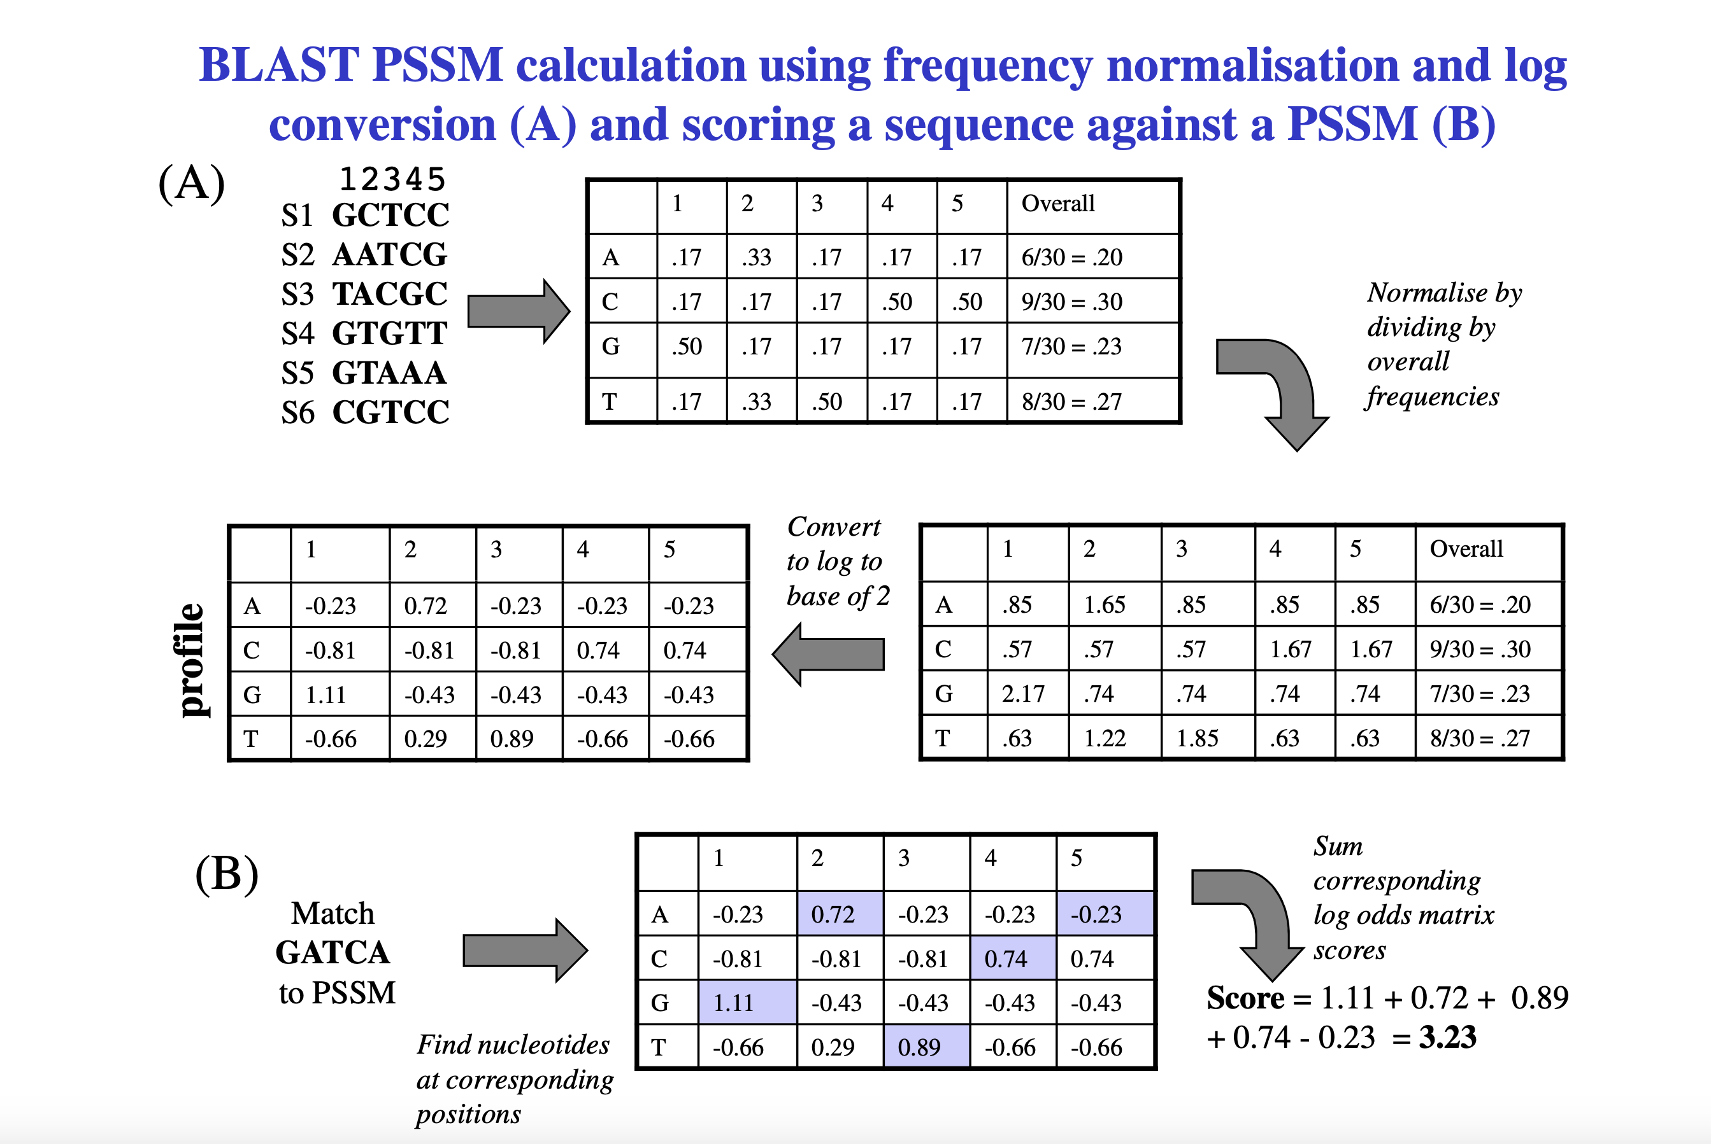

Slide 13
PSI-BLAST is performed in five steps
[1] Select a query and search it against a protein database
[2] PSI-BLAST constructs a multiple sequence alignment
then creates a “profile” or specialized position-specific
scoring matrix (PSSM)
[3] The PSSM is used as a query against the database
[4] PSI-BLAST estimates statistical significance (E values)
B&FG 3e
Page 172

Slide 14
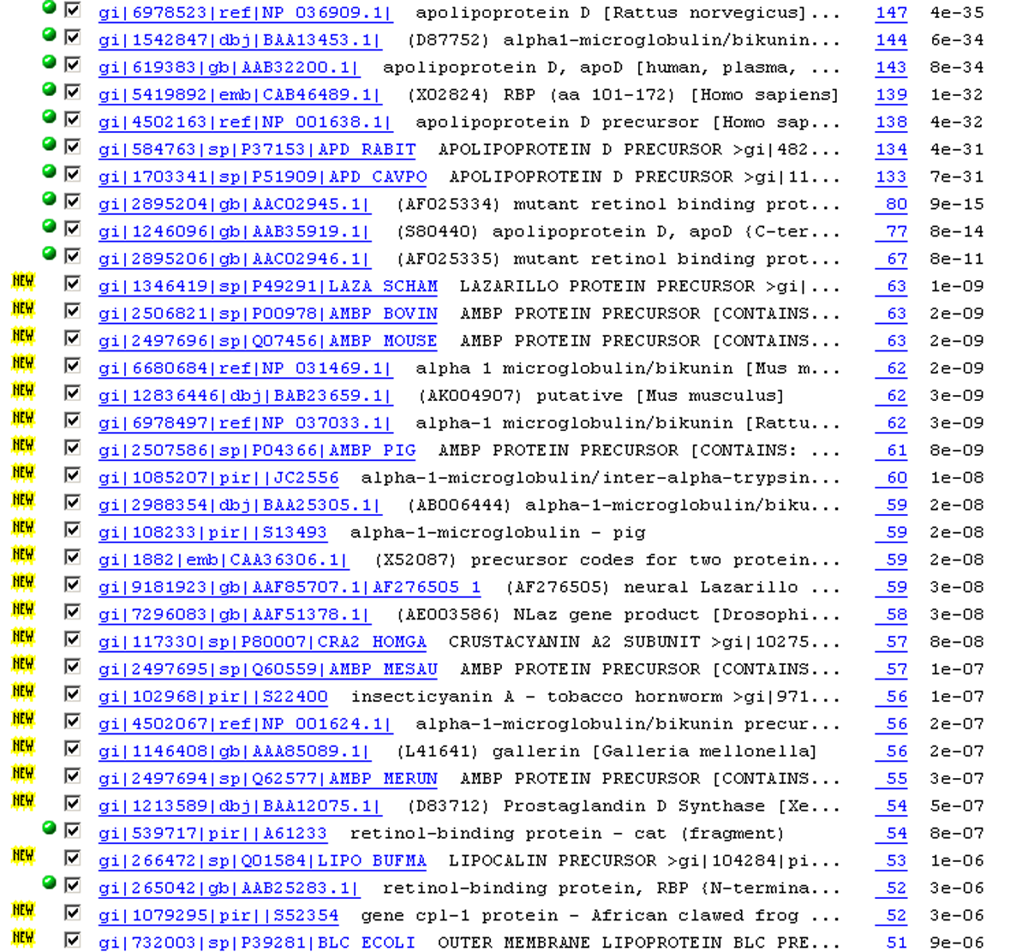

Slide 15
PSI-BLAST is performed in five steps
[1] Select a query and search it against a protein database
[2] PSI-BLAST constructs a multiple sequence alignment
then creates a “profile” or specialized position-specific
scoring matrix (PSSM)
[3] The PSSM is used as a query against the database
[4] PSI-BLAST estimates statistical significance (E values)
[5] Repeat steps [3] and [4] iteratively, typically 5 times.
At each new search, a new profile is used as the query.
B&FG 3e
Page 172

Slide 16
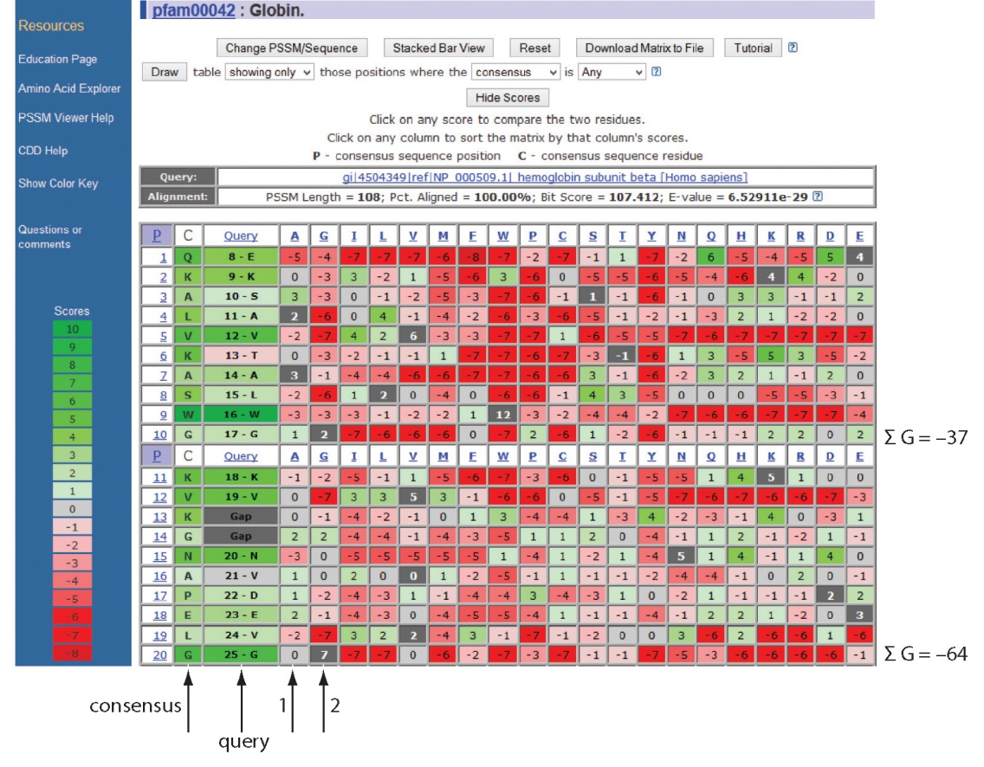
Position-specific scoring matrix (PSSM)
B&FG 3e
Fig. 5.3
Page 173

Slide 17
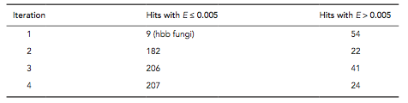
PSI-BLAST: dramatic increase in number of hits
Given this query, a standard BLASTP search would produce about 9 hits with low expect values. This PSI-BLAST search produces >200 hits after 3 or 4 iterations.
B&FG 3e
Table 5.2
Page 174

Slide 18
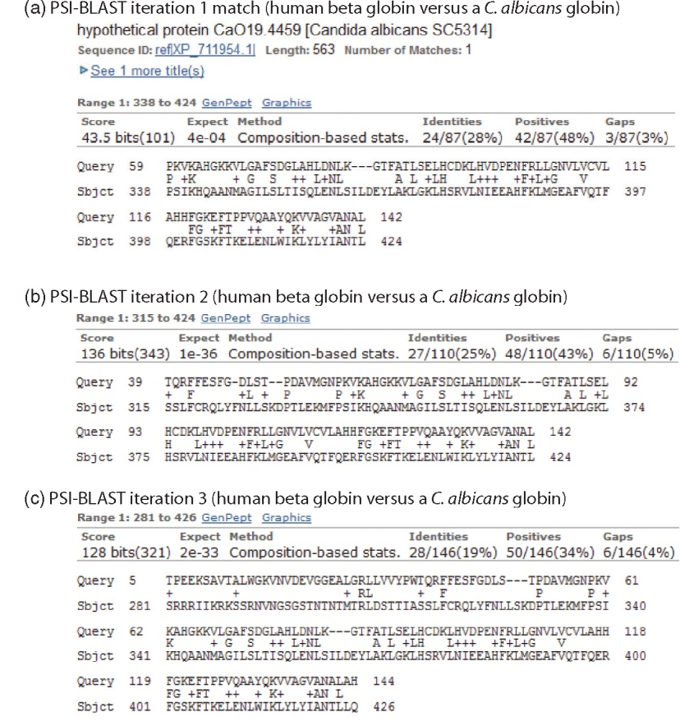
Note that PSI-BLAST E values
can improve dramatically!
After 1st iteration:
Expect = 4e-04
Alignment length = 87 amino acids
After 2nd iteration:
Expect = 1e-36
Alignment length = 110 amino acids
After 3rd iteration:
Expect = 2e-33
Alignment length = 146 amino acids
B&FG 3e
Fig. 5.4
Page 175

Slide 19
The universe of lipocalins (each dot is a protein)
retinol-binding
protein
odorant-binding
protein
apolipoprotein D

Slide 20
Scoring matrices let you focus on the big (or small) picture
retinol-binding
protein
your RBP query

Slide 21
Scoring matrices let you focus on the big (or small) picture
PAM250
PAM30
retinol-binding
protein
retinol-binding
protein
Blosum80
Blosum45

Slide 22
PSI-BLAST generates scoring matrices
more sensitive than PAM or BLOSUM
retinol-binding
protein
retinol-binding
protein

Slide 23
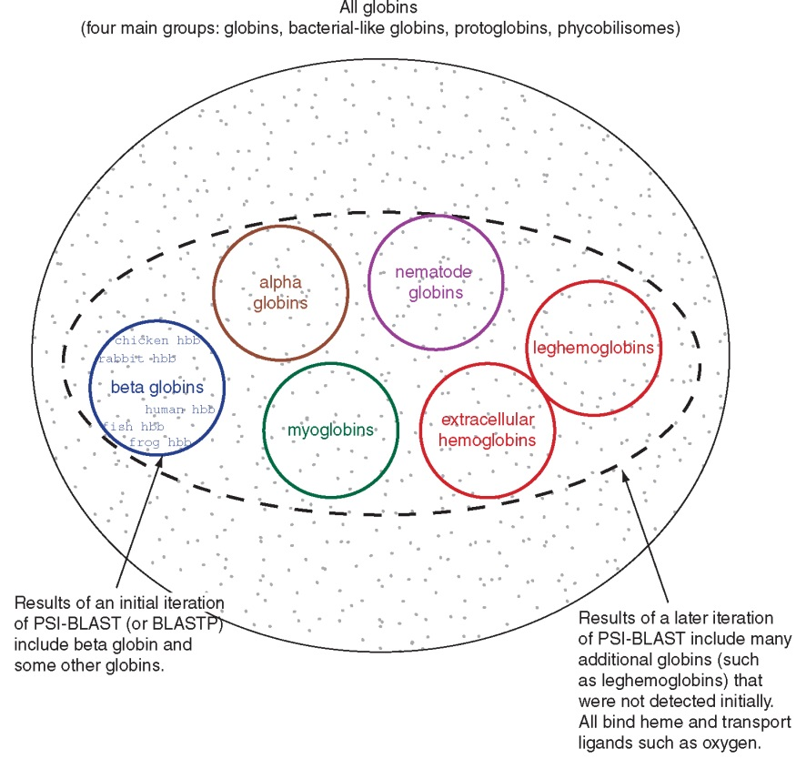
PSI‐BLAST algorithm increases the sensitivity of a database search by detecting homologous matches with relatively low sequence identity
B&FG 3e
Fig. 5.5
Page 176

Slide 24
PSI-BLAST: the problem of corruption
In PSI-BLAST once a match is incorporated into a PSSM it will never be removed, even if it is wrong (i.e. even if it is a false positive that is not truly homologous to the query). Not only will it stay, it may lead to the inclusion of many other related false positive hits.
There are three main approaches to removing false positives:
Filter biased amino acid regions. (This is an option in BLAST.)
Lower the expect value threshold to make the search more stringent.
Visually inspect the output from each PSI-BLAST iteration and remove suspicious matches (by unchecking the corresponding boxes).
B&FG 3e
Page 177

Slide 25
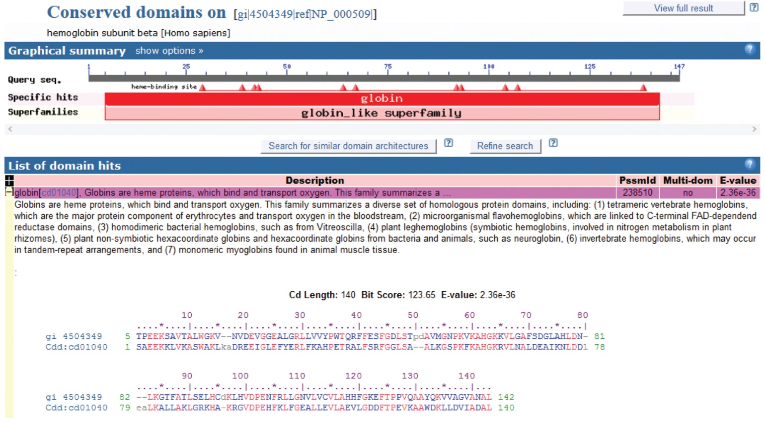
Reverse position-specific BLAST (RPS-BLAST): search a query against a collection of predefined position-specific scoring matrices
B&FG 3e
Fig. 5.6
Page 178
RPS-BLAST searches are incorporated into the Conserved Domain Database (CDD) at NCBI

